Slide 1
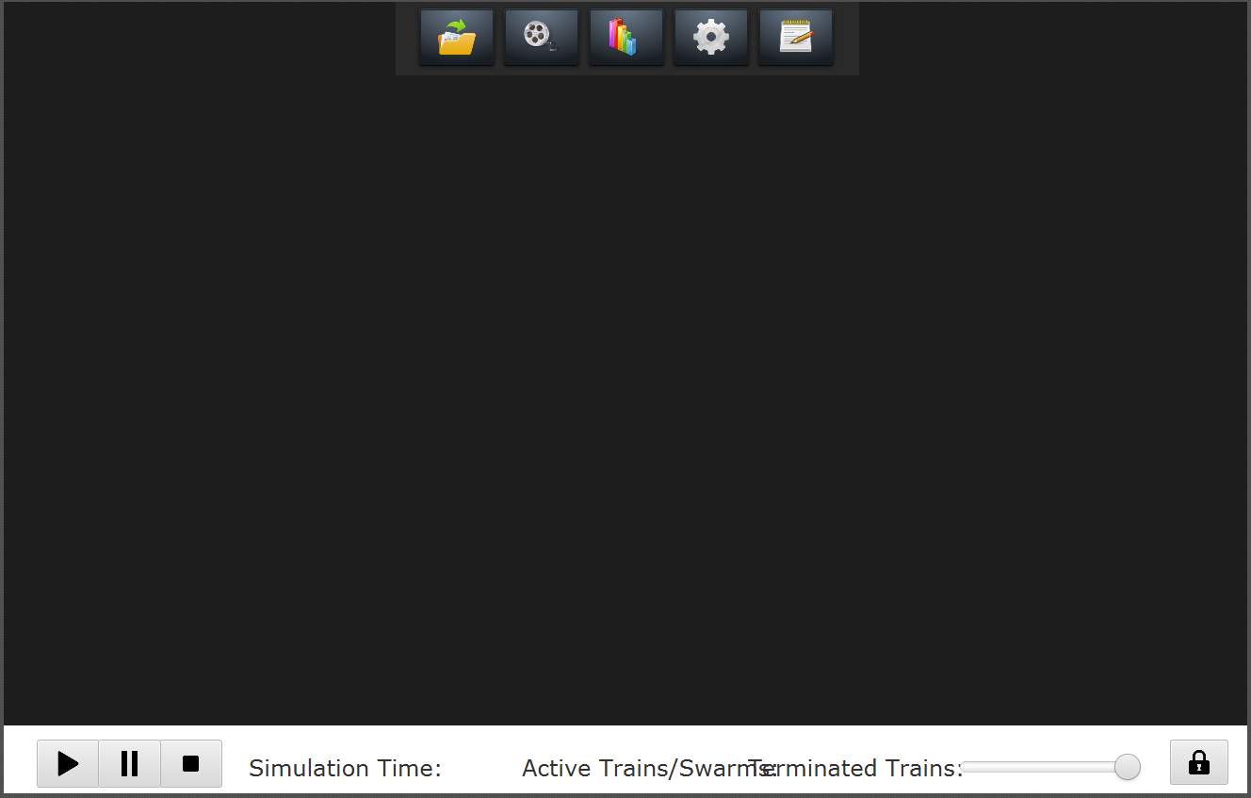

SimulationViewer
menuPane
symbolPane
Defined in: SimulationViewer.fxml
networkPaneRoot
Defined in: SimulationViewerController.java
ConfigurationPaneController
NetworkPaneController
editorPane
NetworkPane
graphPane
GraphPaneController
InfrastructureElementPane
TrainPane

